Slide 1
WebSite Structure
Page Title:
Main page
Content:
-What I sell
-Contact
-List of what I’m selling
Filename:
Index.html
Page Title:
Contact
Content:
My contact details
Filename:
Contact.html
Page Title:
More details (templates)
Content:
Image of what I will be selling
Description of what I’m selling
Filename:
item.html
If you have less than 3 pages, delete the unused ones. If you have more,
Create more.
Grading
All pages have a human-readable title 0 /1
Content for each page defined 0/1
Filenames with no special characters defined 0/1

Slide 2
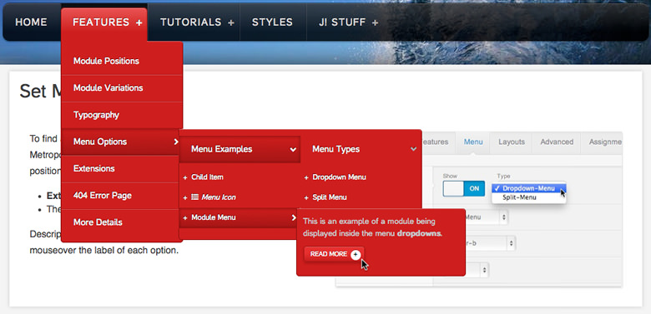
WebSite Design
Example (to be replaced with your own)
Big Screen
Small Screen
Highlight of the week, coming soon or featured item
Highlight of the week, coming soon or featured item
-Shoes
(Side drop)
-Accessories
(Side drop)
-Sales
(Side drop)
Dropdown menu
Item
Small description of item
Item
Small description of item
Item
Small description of item
Item
Small description of item
Item
Small description of item
Image
Image
Item
Small description of item
Image
Image
Item
Small description of item
Image
Image
Image
Contact information
Item
Small description of item
Image
Item
Small description of item
Image
Contact information
Grading
Location of major design parts clear for large screens 0 /1
Location of major design parts clear for small screens 0 /1

Slide 3
WebSite Design - Template
Example (to be replaced with your own)
Big Screen
Small Screen
-Shoes
(Side drop)
-Accessories
(Side drop)
-Sales
(Side drop)
Menu
Item
Description
Size
Fit
Image
(multiple image, can go in loop)
Item
Description
Size
Fit
Image
(multiple image, can go in loop)
Previous item Home Next item
Contact information
Previous item Home Next item
Contact information
Grading
Location of major design parts clear for large screens 0 /1
Location of major design parts clear for small screens 0 /1

